Slide 51
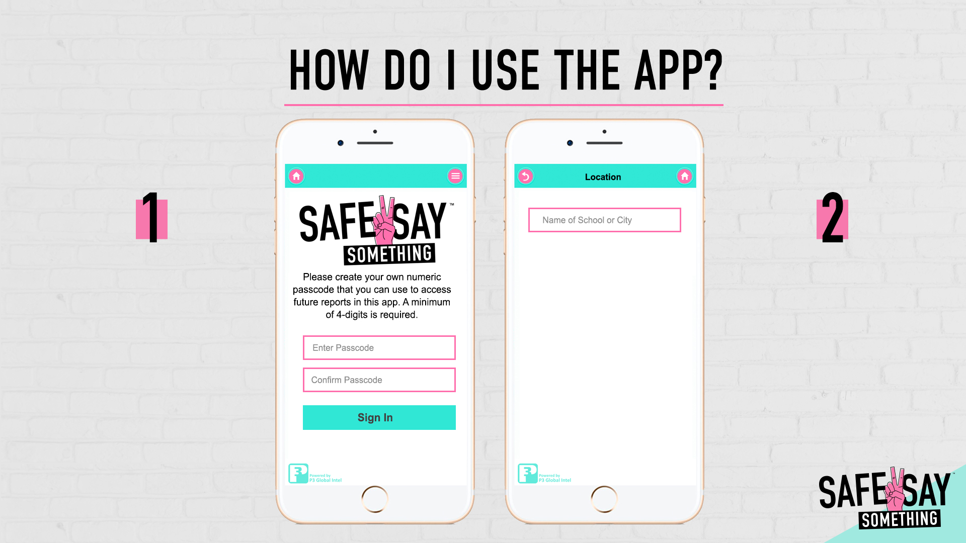
CREATE AND ENTER A 4-DIGIT PASSCODE WHEN PROMPTED
ENTER THE SCHOOL NAME YOU ATTEND BU TYPING IN ITS NAME OR SEARCHING BY CITY OR TOWN

Slide 52
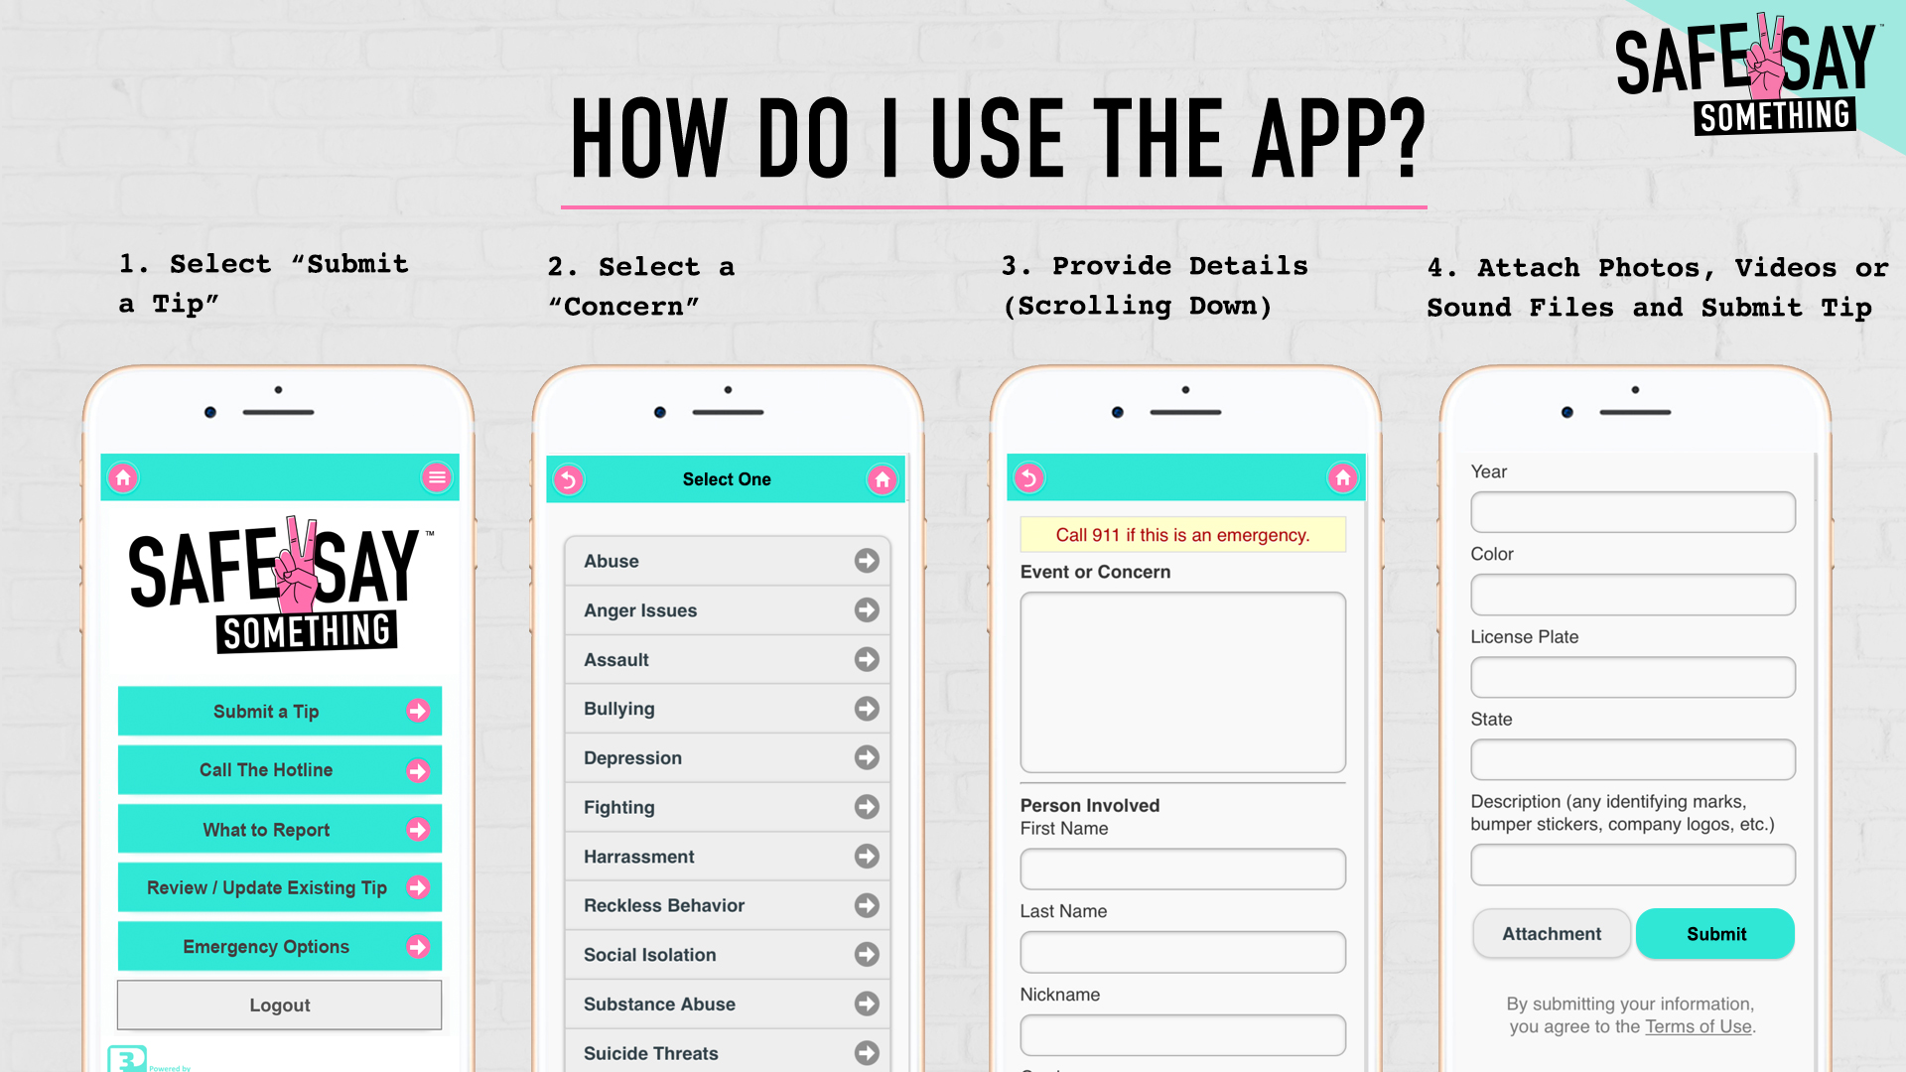

Slide 54
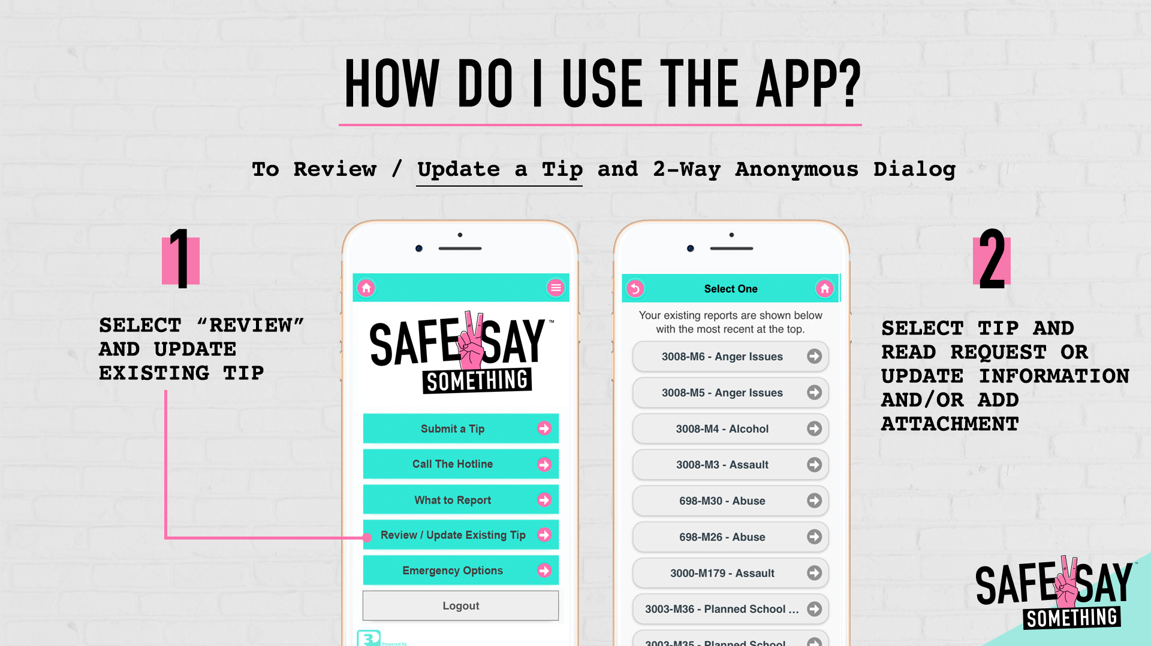

Slide 56
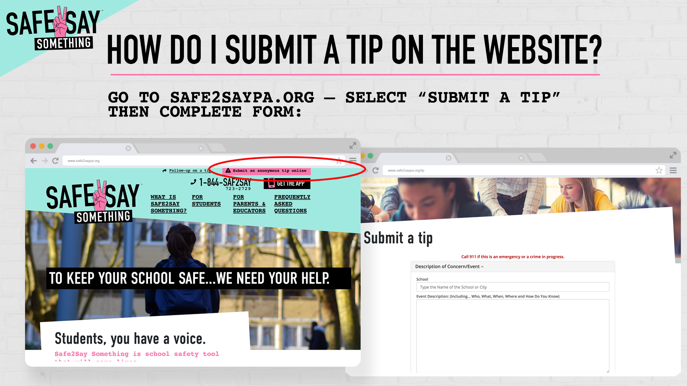

Slide 62
52

Slide 63
53

